Slide 1
OpenCommerce Group

Slide 2


Worker, Cron Job
12
Revisit golang concurrency
Worker & Cron Job
RabbitMQ in action
Worker with RMQ
Docker

Slide 3
Agendas
Part 1: Worker, Conjob & RMQ
Why revisit?
Golang concurrency
Schedule job with robfig/cron
Simple Cron & Worker with golang
RabbitMQ
Why we need?
Terms & Architecture
From channel to RMQ
Alternative

Slide 4
Part 1: Worker, Conjob & RMQ

Slide 5
Why revisit?
Don’t use regularly → Won’t understand/remember

Slide 6
Revisit
ES
JWT
Practices

Slide 7
Golang concurrency (Revisit)
Goroutine
Channel
Unbuffered
When do we use it?
Receiver need to be ready before sending data to
Buffered
When do we use it?
<-chan, chan<-
What’s that?
Mutex
Mutex
RWMutex
WaitGroup
Select
Which cases is ready for use?
How to stop a goroutine?

Slide 8
Schedule job with robfig/cron
Use-cases
Run a specific job at a specific time
Periodically: 1 job/minute
How to?
Use time.Ticker, time.After …
Does it block next job?
Use robfig/cron for more features
Can use *nix cron format
Thread-safe
Multiple jobs will be triggered, don’t need to wait for others
Minimize duplicated code compared to the time package
Note
can use test instead of writing main package

Slide 9
Simple Worker with native golang
Task
Suppose we have an online store
Anytime Buyer/Customer make a purchase from our store, we need to send them some emails like:
Thank you email
Order confirmation
Shipping update
So how to do that in real world application, anyway?

Slide 10
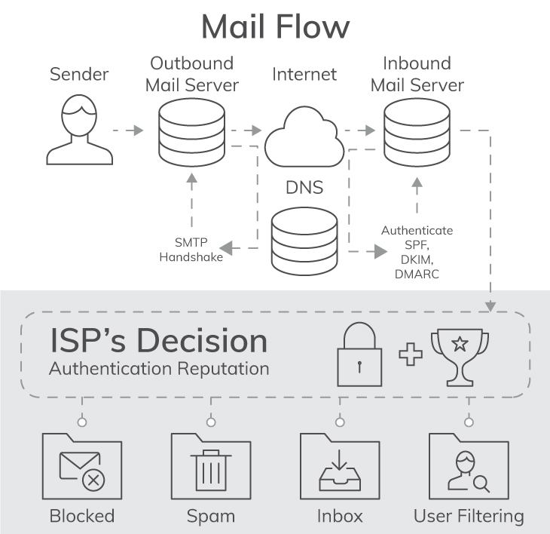

Sending email
Sendgrid
Why?

Slide 11
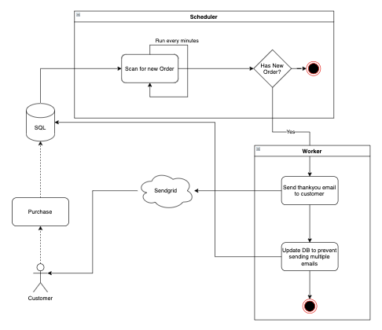

Slide 12
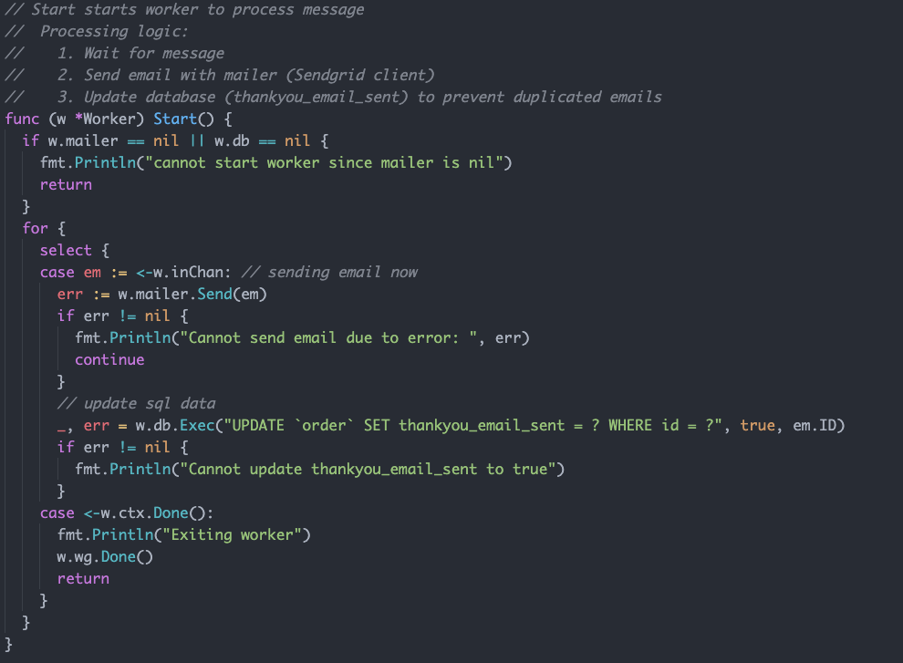
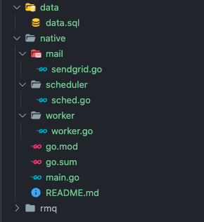

Slide 13
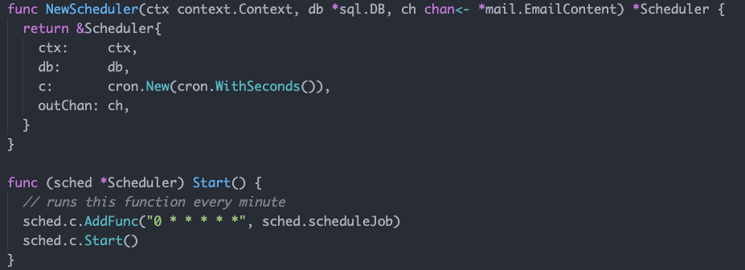
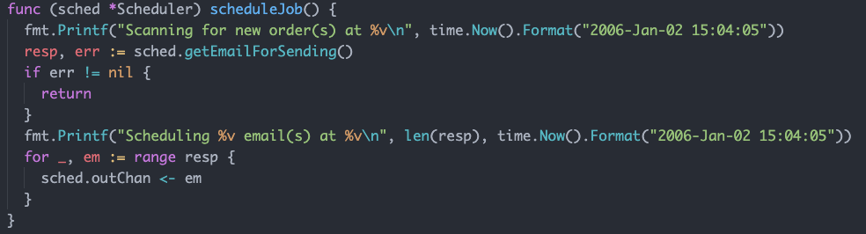

Slide 14
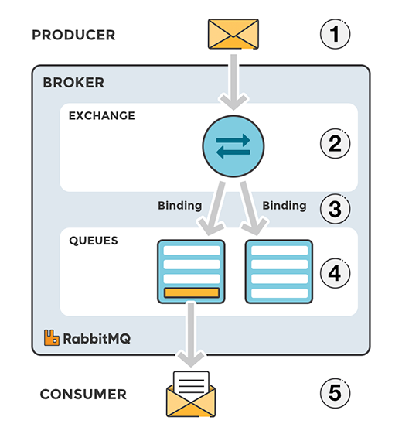
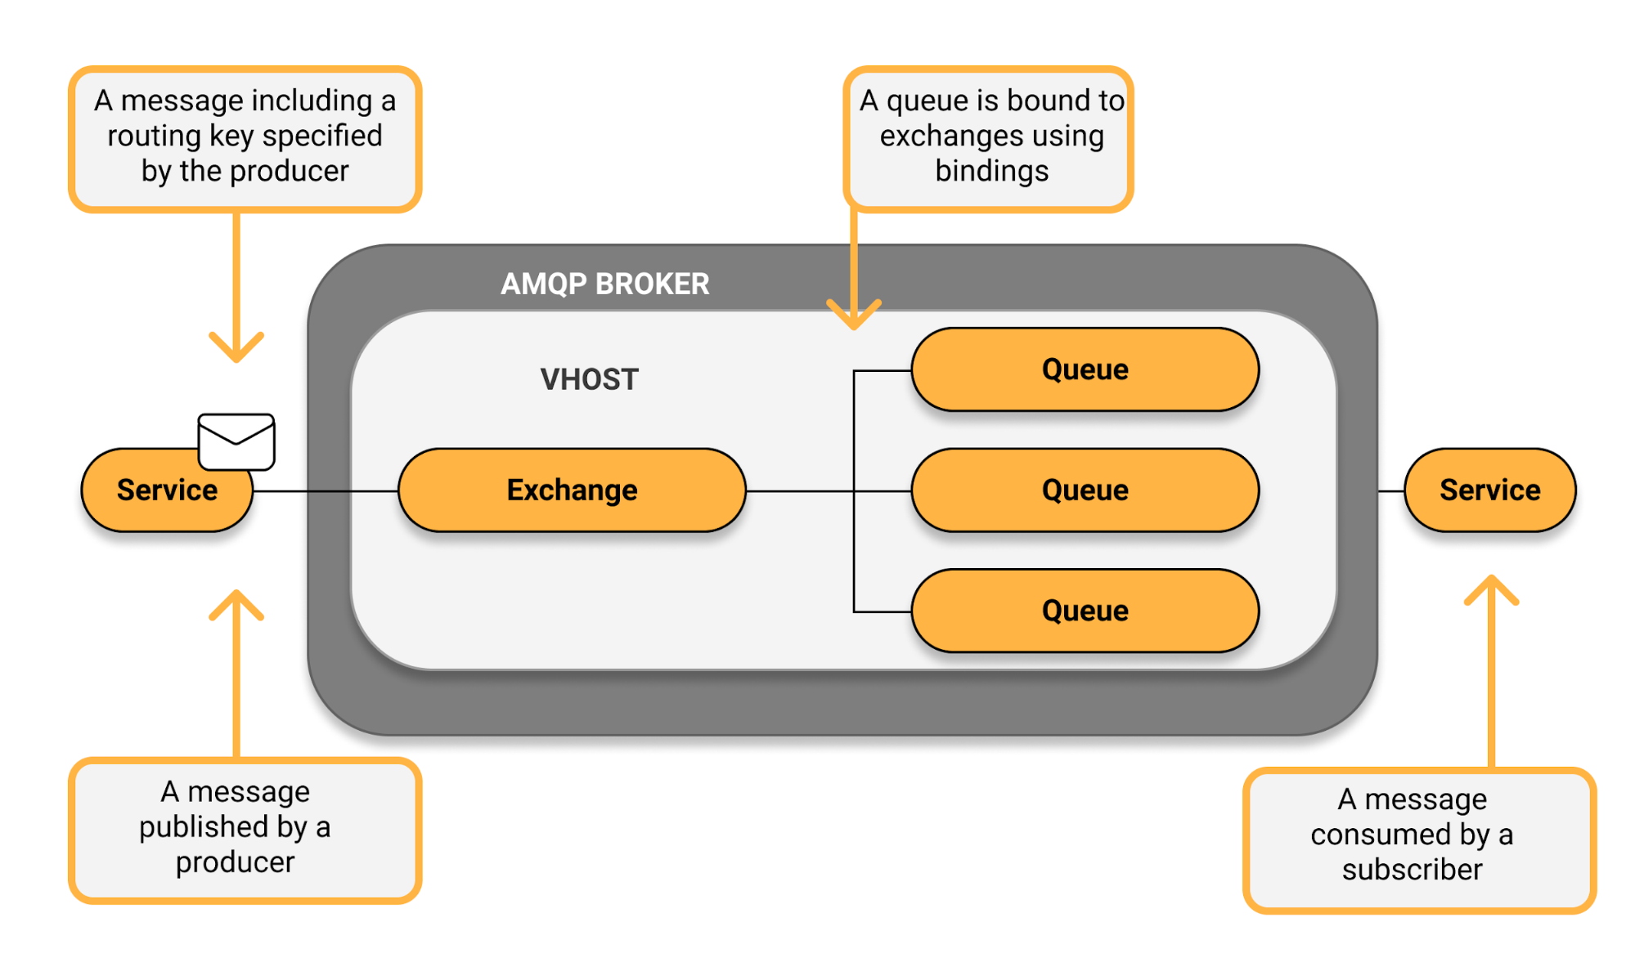
AMQP & RabbitMQ
AMQP
^!%$@%^!
Advanced Message Queuing Protocol - Just a Protocol
Why advanced?
Routing

Slide 15
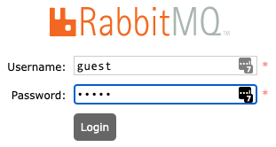

RabbitMQ
Up & Run with docker-compose
Use docker-compose to run docker-compose.yml file
docker-compose -f docker-compose.yml up
Get more detail here
Ports
15672: management UI powered by its plugin
5672: native port - one that scheduler/worker/api/app... will work with
Management UI
Default account: guest/guest
Demo
Simple actions with UI

Slide 16
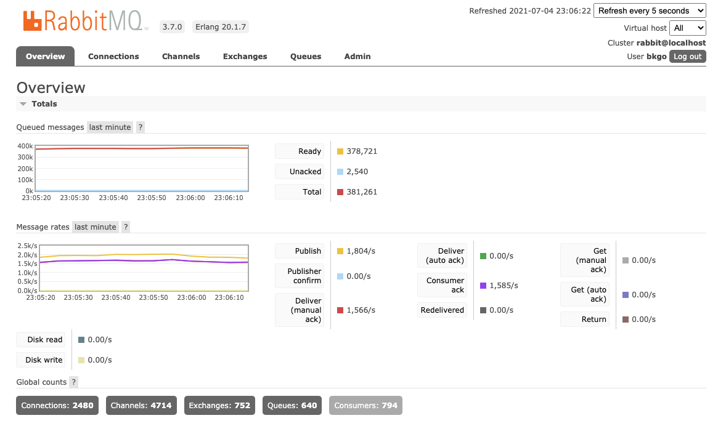
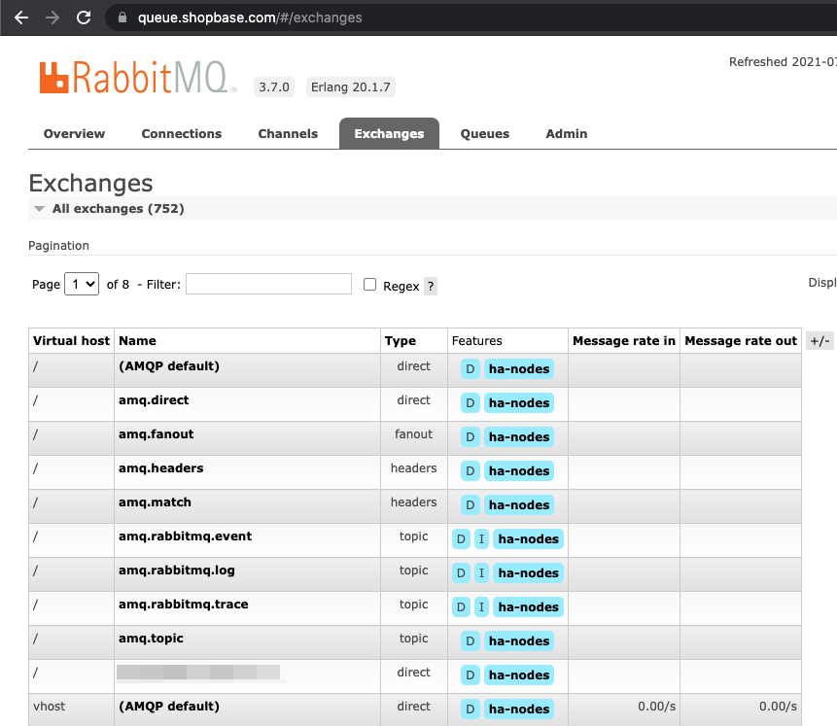
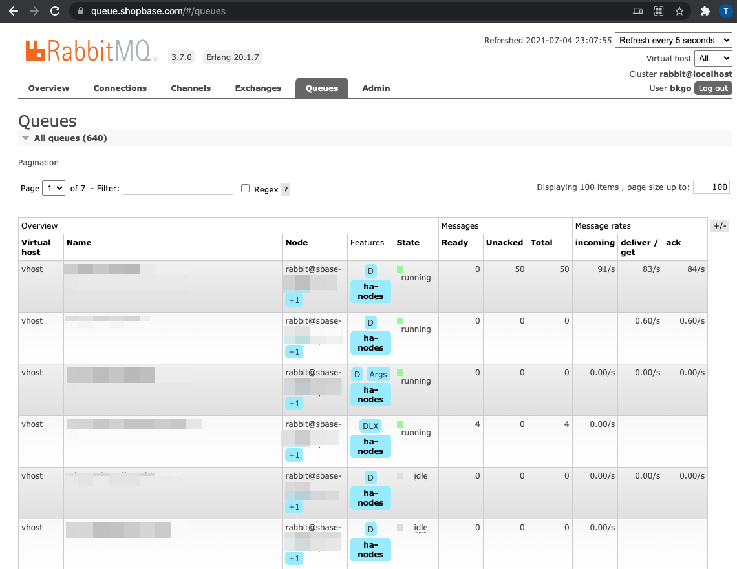

Slide 17
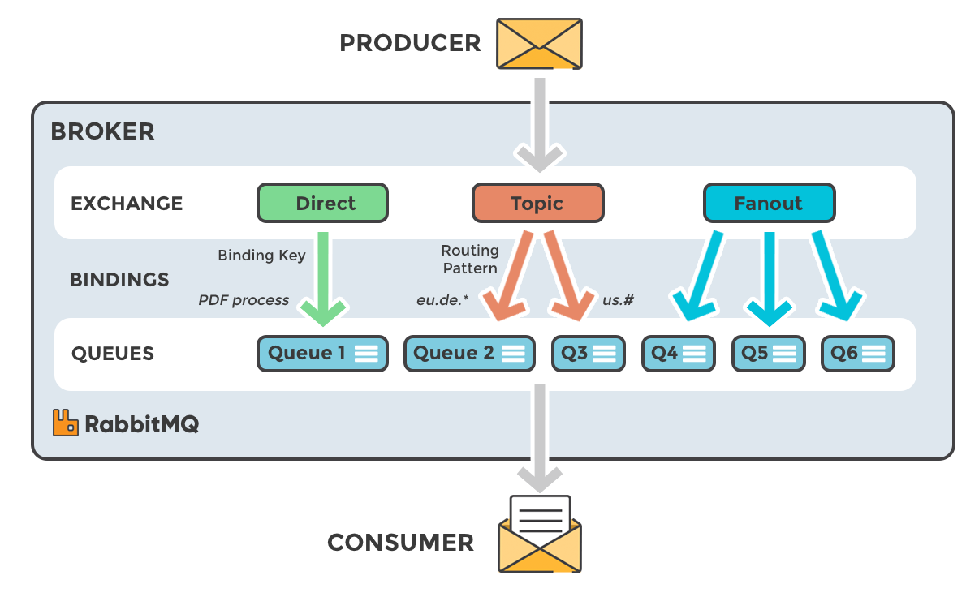
RabbitMQ
Implements AMQP
Terms
Vhost
Exchange
Queue
Binding & Routing
Producer, Consumer, Broker
Connection & Channel

Slide 18
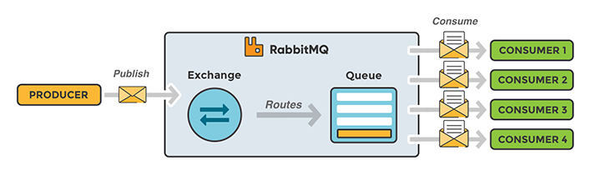
Worker/Scheduler w/ RabbitMQ
Looks familiar?
Can work across processes/servers.
Has better memory management (in some way) than in a single golang process
Easier to scale out or up
Multiple sender (producer) & multiple receiver (consumer)

Slide 19
RabbitMQ Producer
Act as a data generator that provide data/job/task for workers to work
Produce/send message(s) to Exchange
Depends on routing configuration, message will be route to one or more queues or nowhere (if exchange is not binded to any queue)
Also we can send message directly to Queue via the UI, but it’s not recommended
Can break application’s flow
How does that work?
Default Exchange

Slide 20
RabbitMQ Consumer
Act as a worker
Consumer read/consume message(s) from Queue (not from exchange)
After message received/processed, consumer need to ACK to tell RabbitMQ server that server can delete message from its queue
Can prefetch message if needed
Can automatically ACK if setting is set

Slide 21
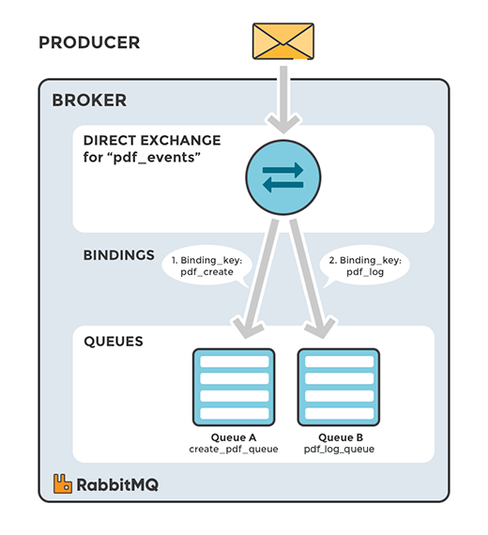

When routing comes to picture?
Direct
Topic
Fanout
Header
A message goes to the queue(s) with the binding key that exactly matches the routing key of the message

Slide 22
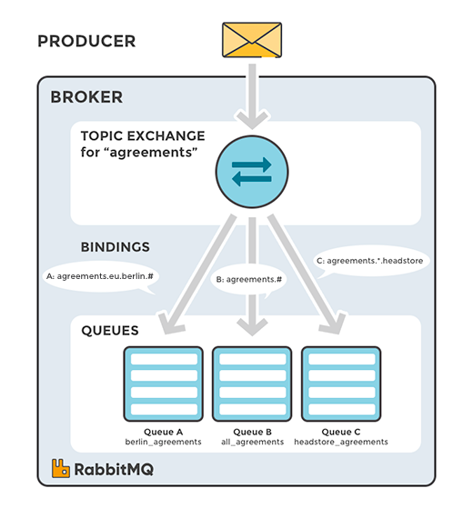
When routing comes to picture?
Direct
Topic
Fanout
Header
Topic exchanges route messages to queues based on wildcard matches between the routing key and the routing pattern, which is specified by the queue binding. Messages are routed to one or many queues based on a matching between a message routing key and this pattern

Slide 23
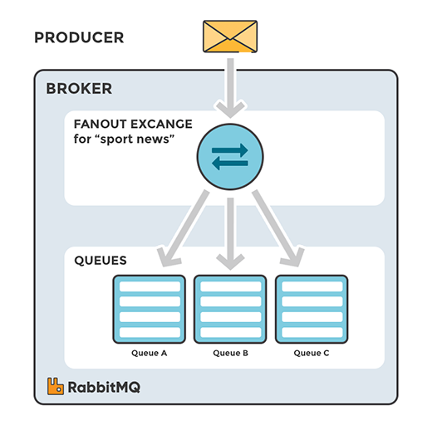
When routing comes to picture?
Direct
Topic
Fanout
Header
A fanout exchange copies and routes a received message to all queues that are bound to it regardless of routing keys or pattern matching as with direct and topic exchanges. The keys provided will simply be ignored.

Slide 24
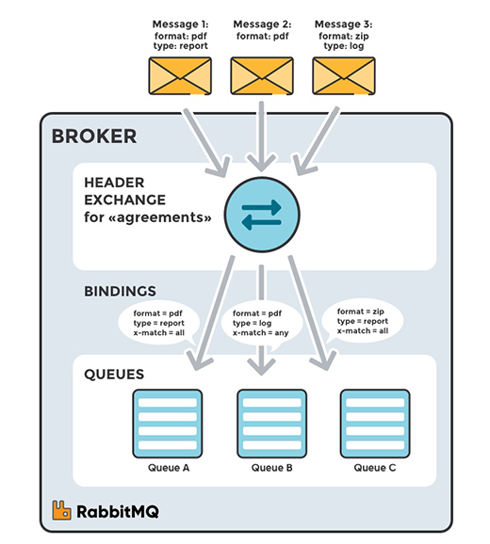
When routing comes to picture?
Direct
Topic
Fanout
Header
A headers exchange routes messages based on arguments containing headers and optional values. Headers exchanges are very similar to topic exchanges, but route messages based on header values instead of routing keys. A message matches if the value of the header equals the value specified upon binding.

Slide 25
Dead Letter Exchange
If RMQ cannot find any queue corresponding to an exchange for delivery message → the messages will be dropped.
There’s a way to get these messages
Dead letter exchange
Quite advanced topic - will be presented in Reading session

Slide 26

How to move logic from internal process to RabbitMQ?
Channel is the key
Library: https://github.com/streadway/amqp

Slide 27
Practice: Convert Scheduler/Worker to use RabbitMQ

Slide 28
RabbitMQ
Issue with the library
Re-connect
...

Slide 29
Resource
Reading & Exercises:
Handouts
Code
https://github.com/Beeketing/tfs-02/tree/master/lec-12/demo

